Slide 1
Digital Communications: Error Correction Codes for Wireless Communication Systems
Sami Khorbotly, Ph.D., IEEE member
Assistant Professor
Dept. of Elec. & Comp. Eng. & Comp. Sc.
Ohio Northern University

Slide 2



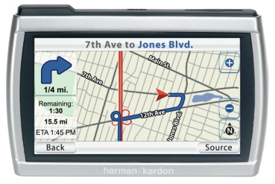
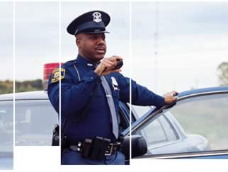

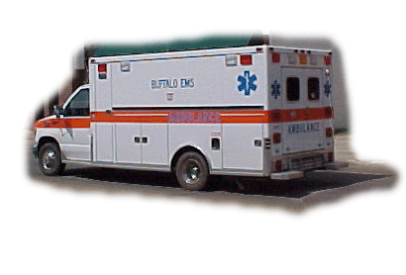
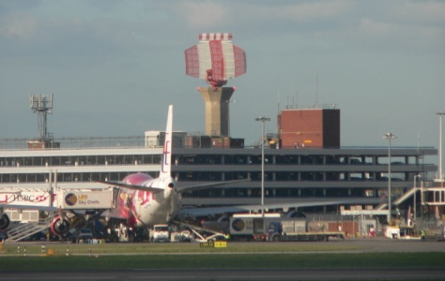
Wireless Communications
Cell phones
TV & radio
broadcasting
Wireless internet
Geolocation/GPS
911 services
Transportations
Law enforcement
Military/Battlefield

Slide 3



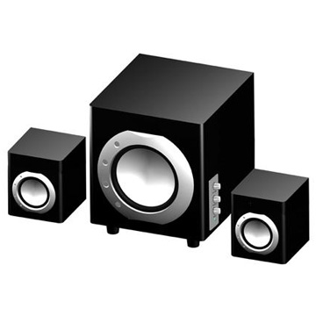
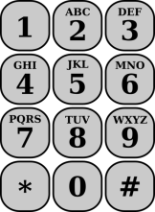

Types of Transmitted Data
Image/video
Image/video & text
Files/data
Transmitter
Receiver
Text messages
Speech/music
Speech/music
Files/data

Slide 4

Sample Communication System (Image)
Modulated binary signal
…110100…
Binary signal
…100101…
Binary signal
…100101…
Source Encoder
Transmitter
Receiver
Source Decoder

Slide 5
Noise, Interference & other issues
Unfortunate, error causing effects in the wireless communication channel :
Multi-path propagation of the signal
Interference from other communication devices

Slide 6
How does error occur?
Transmitted data bits
1 0 0 1 1 0 1 0 1 0 0 0 1 0 1 1 1 0 1 0
Transmitted waveform
Received waveform
Received data bits
1 0 1 1 0 1 0 0 1 . . .

Slide 7
Text Message Example
…1001010
1010011100010010010110010…
Noise &
interference
Fire at 100 Main St.
Source Encoder
Transmitter
…1011010
1011011000010100010100010…
Fore as 140 Vain St@
Source Decoder
Receiver

Slide 8
Society Without Reliable Comm.
Cell Phones
Hard to hold a meaningful conversation (voice)
TV & Radio Broadcasting
The corrupted image/Music will turn the audience away
Wireless internet
Corrupted emails
Credit card purchases not going through
Surfing the net is so annoying it is not even worth it
Geolocation/GPS
Good luck getting to your destination

Slide 9
Society Without Reliable Comm.(Cont)
911 Services
Paramedics/fire fighters going to the wrong address; potential loss of lives and property
Transportations
Airplanes simultaneously landing on the same runway
Boats colliding across the oceans
Law Enforcement
Officers unable to call for backup
Military/Battlefield
Combat units moving/firing in the wrong direction

Slide 10
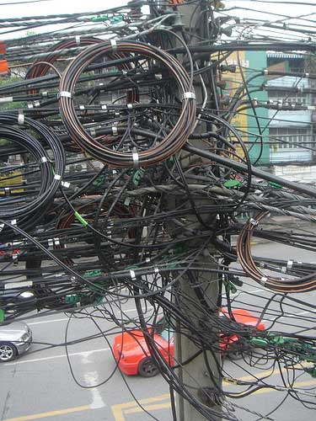
What Can We Do?
Who cares about wireless communications? Let’s wire every thing up.
Come up with a way to reduce error the error in the received signal.
Error Correction Coding
Also known as
Channel Coding

Slide 11
Channel Encoding
Source Encoder
Channel Encoder
Transmitter
Source Decoder
Channel Decoder
Receiver
Additional blocks
Channel encoder at the transmitter side
Channel decoder at the receiver side

Slide 12
Error Correction Coding
Channel encoder: Manipulates the source data in such a way to reduce the probability of error in the received signal
Channel decoder: At the receiver side, designed in coordination with the encoder to recover the source data
Infinite possibilities and designs of encoder/decoder pairs
The probability of error can be significantly reduced at the expense of a lower transmission rate

Slide 13
Redundancy Coding
In n-redundancy coding, each data bit is encoded in n bits.
For example, in a 3-redundancy coding scheme, a ‘0’ data bit is encoded as ‘000’ and a ‘1’ data bit is encoded as ‘111’.
The channel decoder generates a data bit out of a block of n bits. (3 in the example)
100
111000000
111000000
100
Channel Encoder
Channel Decoder

Slide 14
How does it reduce the error?
The decoder is taking blocks of n bits. (n=3 in the example)
The decoder expects all n bits to have the same value
When the n bits in a block do not have the same value, the decoder detects an error
Some of the errors can be corrected
000
0
001
Channel Decoder
0
111
1
101
1

Slide 15
Signal Transmission Example
001011
000|000|111|000|111|111
Channel Encoder
6 data bits
18 encoded bits
(3 redundancy)
000011
010|001|100|100|011|011
Channel Decoder
1/6 decoded bits are erroneous
7/18 received bits are erroneous
Error reduced from 7/18 bits (38.89%) to 1/6 bits (16.67%)
Notice the one data bit still received in error

Slide 16
Correction Abilities of Codes
Assuming a ‘0’ data bit is transmitted:
In a 3-redundancy coding, the transmitted coded word is ‘000’
Received | 000 |  | 010 |  | 100 | 101 |  | 111
Decoded | 0 |  | 0 |  | 0 | 1 |  | 1
In a 5-redundancy coding, the transmitted coded word is ‘00000’
Received | 00000 |  | 00010 |  | 01001 | 01011 |  | 10111
Decoded | 0 |  | 0 |  | 0 | 1 |  | 1
3-redundancy coding can correct 1 error bit in a coded word
5 redundancy coding can correct up to 2 error bits in a coded word

Slide 17
Correction Abilities of Codes (cont.)
General formula:
n-redundancy coding can correct up to (n-1)/2 bits in a code
The larger the value of n, the higher is the correction ability
Why do we not use a really large value for n, let’s say a
1,000,000 redundancy encoder?

Slide 18
Time Performance Trade-off
Assume a communication system operating at a rate of 100 kilo bits per second (kbps)
If the data to be transmitted is 10 kilo bits, the non-coded signal will be transmitted in 10/100=0.1 sec
The encoded signal containing more bits will take longer:
n
1
2
5
10
100
Time (sec)
0.1
0.2
0.5
1
10

Slide 19

Trade-off decision
Time delay between parties
If the delay in the original (non-coded) system is 1 ms
The original system results in 30% bit error rate (BER)
Are you willing to use an encoding that reduces the BER to 5 % at the expense of increasing the delay to 10 ms?
How about an encoding that reduces the BER to 0.2 % at the expense of increasing the delay to 2 s?

Slide 20
Delay Sensitivity
Different application can afford different levels of delay
A 30 seconds delay is affordable when sending an email or downloading a file
A 30 seconds delay between talking parties is unacceptable. Especially if law enforcement or emergency situations are involved
Design engineers make their decision based on the sensitivity and nature of their application

Slide 21
Convolutional Coding
Also reduces the error in communication systems
Can achieve higher error correction at a relatively lower cost, compared to n-redundancy coding
A m/n convolutional encoder is a sequential system that generates an n bit codeword out of m data bits
The coded signal is generated by generator polynomials and modulo-2 adders.
A | B | A B
0 | 0 | 0
0 | 1 | 1
1 | 0 | 1
1 | 1 | 0
Truth table of a Modulo-2 adder

Slide 22
Convolutional Coder Example
In a 1/3 encoder with generator polynomials:
G₁ = (1,0,1), G₂ = (0,1,1), & G₃ = (1,1,0).
For each data bit x(i) corresponds a 3-bit code y₁(i)y₂(i)y₃(i) with:
x(i), x(i-1), and x(i-2) denote the present, previous and 2 sample delayed inputs.
It is assumed that the system is originally reset to ‘0’

Slide 23
Example (cont.)
x(i-1), x(i-2) are originally set to 0,0
if the data bit x(i)=0, the output is y=000
if the data bit x(i)=1, the output is y=101
For the second bit:
if the first bit was a 1, x(i-1), x(i-2) are 1,0
if the second data bit x(i)=0, the output is y=011
if the second data bit x(i)=1, the output is y=110
if the first bit was a 0, x(i-1), x(i-2) are still 0,0
if the second data bit x(i)=0, the output is y=000
if the second data bit x(i)=1, the output is y=101
This approach can be adopted to build a tree diagram

Slide 24
x(i,i-1,i-2):000
Output: N/A
x(i,i-1,i-2):000
Output:000
x(i,i-1,i-2):000
Output:000
x(i,i-1,i-2):100
Output:101
x(i,i-1,i-2):100
Output:101
x(i,i-1,i-2):010
Output:011
x(i,i-1,i-2):110
Output:110
x(i,i-1,i-2):000
Output:000
x(i,i-1,i-2):100
Output:101
x(i,i-1,i-2):010
Output:011
x(i,i-1,i-2):110
Output:110
x(i,i-1,i-2):001
Output:110
x(i,i-1,i-2):101
Output:011
x(i,i-1,i-2):011
Output:101
x(i,i-1,i-2):111
Output:000
X(i)=0
X(i)=0
X(i)=1
X(i)=0
X(i)=0
X(i)=1
X(i)=1
X(i)=0
X(i)=1
X(i)=0
X(i)=1
X(i)=0
X(i)=1
X(i)=1

Slide 25
Example (Cont.)
Since each codeword is made of 3 data bits, x(i,i-1,i-2), the decoder reads the code words corresponding to 3 data bits
The codes corresponding to 3 data bits are 9 coded bits
According to the tree, there are only 8 valid sequences
Valid code sequences | mismatch
000 000 000 | 5
000 000 101 | 7
000 101 011 | 5
000 101 110 | 5
101 011 110 | 5
101 011 011 | 5
101 110 101 | 5
101 110 000 | 3
Received code sequence:
110 110 010
Minimum
mismatch

Slide 26
Convolutional Coder Design
For each encoder corresponds a different tree diagram
Different coding rates & different generator polynomials result in different error correction performances
A convolutional coder with 2 or more valid code sequences that are separated by one bit is a poor coder
A better convolutional coder is where the valid code sequences are significantly separated/different from each other

Slide 27
Valid Code Sequence Separations
Valid code sequences
000 000 000
000 000 101
000 101 011
000 101 110
101 011 110
101 011 011
101 110 101
101 110 000
2
4
4
2
6
etc
4
2
4
2

Slide 28
Important Definitions
Modeling
Finding the mathematical equations that describe the behavior of a physical system
Computer simulation
Using the mathematical models to imitate the functionality of a real process. Commonly used to compare the performance of alternative designs before implementation
Matlab
A numerical computing and programming environment. Popularly used to perform computer simulations

Slide 29
Computer Simulation
Transmitter
Receiver
Simulation blocks supplied by the instructor:
Image to binary converter
Transmitter
Wireless channel
Receiver
Binary to image converter
Blocks expected from you:
Encoder
Decoder

Slide 30

Real-life System
Simulation blocks supplied by the instructor:
Image to binary converter
Transmitter Interface
Receiver Interface
Binary to image converter
Blocks expected from you:
Encoder
Decoder
The Transmitter, Receiver, and channel in this system are all real and not simulated

Slide 31
Project
Get familiar with the Matlab environment
Take a look at the supplied simulation blocks to get familiar with Matlab programming language (very similar to C)
Write two Matlab codes to simulate respectively an encoder and a decoder using the n-redundancy scheme.
Run the simulation for various values of n to observe its effect on the performance of the system and the transmission time.

Slide 32
Project (cont.)
Create a plot of the BER performance versus the coding rate n
Create another plot of the processing time versus the coding rate n
Create convolutional coding system. Find the BER and the processing times corresponding to your system

Slide 33
Questions ?

